Slide 1
Generating Synthetic images using GAN models
Project Phase-1
Batch-B, Group - 2

Slide 2
PROJECT GUIDE – Dr. Sowmya V
Team Members Sai Chandana J – CB.EN.U4AIE21118
Pranish Kumar M - CB.EN.U4AIE21137
Charishma Chowdary T - CB.EN.U4AIE21169

Slide 3
Introduction
BRVO Overview: Branch retinal vein occlusion (BRVO) is a common retinal vascular disorder that blocks retinal veins,impairing blood flow and leading to retinal damage. It is a significant cause of visual impairment, especially in theelderly.
Treatment Options: Treatments like anti-VEGF injections and laser therapy are commonly used to reduce macular edema in BRVO patients, with the severity of visual impairment varying based on the extent of obstruction and treatment effectiveness.
Challenges in Treatment Prediction: Predicting the number of treatments required and overall cure rate is difficult, often necessitating multiple follow-up visits for optimal patient management.
Role of GANs and OCTA: Integrating GANs with OCTA can help develop predictive models for personalized treatment, improving clinical decision-making, patient outcomes, and optimizing healthcare resources.
Role of GANs and OCTA: Integrating GANs with OCTA can help develop predictive models for personalized treatment, improving clinical decision-making, patient outcomes, and optimizing healthcare resources.
65
82
44
73

Slide 4
Problem Statement
Branch retinal vein occlusion (BRVO) leads to unpredictable visual impairment and varying treatment needs,complicating outcome prediction. This project uses GANs to generate synthetic data from initial visit information, including the complete treatment records of 11 patients, to enhance predictions of treatment needs and cure rates. The goal is to enable personalized and efficient treatment plans for BRVO patients.

Slide 5
Literature Survey
Generative Adversarial Networks (GANs) have been applied to medical imaging for data augmentation, image synthesis, and enhancing model training across various modalities like MRI, CT, and retinal images.
GANs help with tasks such as segmentation, anomaly detection, and image enhancement but face challenges in generalization, clinical integration, and anatomical accuracy.
Synthetic Data Generation shows promise for improving model performance, especially in under-represented datasets, but requires evaluation of real-world efficacy.
In the retinal domain, GANs have been used to generate synthetic retinal images, improving data augmentation for deep learning models.

Slide 6
Research Gaps
Incomplete Treatment Data: Limited patient data hampers the ability to predict long-term outcomes for those who have not completed all treatments.
Synthetic Data Generation: Using GANs to generate synthetic progression data for patients missing complete treatment records.
Longitudinal Data: Integration of longitudinal data to enhance the prediction of long-term treatment needs and outcomes.
Predicting Disease Trajectory: This approach helps forecast the disease progression after one treatment and determines the future number of treatments needed from the initial visit.

Slide 7
Dataset
We are using SOUL dataset which is related to vision-threatening retinal vascular condition called Branch Retinal Vein Occlusion (BRVO), images are obtained through Optical Coherence Tomography Angiography (OCTA).
This dataset contains images of 53 patients collected at the Affiliated Hospital of Shandong Second Medical University between 2020 and 2021.
This dataset contains 6 substages which are surgeries and the follow up 2 vists after each surgery.

Slide 8
Methodology
Conditional Recurrent GAN (CRGAN)
The CRGAN model utilizes a Conditional Recurrent GAN (CRGAN) with a Recurrent Generator and a Conditional Discriminator.
The Generator uses an LSTM layer to capture sequential dependencies from noise, patient IDs, and treatment stages.
The Generator design combines LSTM layers with patient and stage embeddings, followed by transposed convolutional layers to generate realistic images that align with the provided conditions.
The Discriminator takes both the image and its corresponding patient ID and stage embeddings, concatenates them with the image, and passes them through convolutional layers to classify the image as real or fake.

Slide 9
Contd..
The GAN was trained over multiple epochs, with the generator's performance monitored by recording and plotting the losses of both the Generator and Discriminator to track improvements over time.
Now , after this the images generated in this GAN model are given to another GAN model(Pix2Pix) for generating a label for the image.

Slide 10
Pix2Pix GAN
A Generator model was defined with an encoder-decoder architecture to transform input images into target images, while the Discriminator model used convolutional layers to distinguish between real and generated images.
Binary Cross-Entropy Loss (BCELoss) was used for both the Generator and Discriminator, with an additional L1 loss incorporated into the Generator to improve image quality.
The models were optimized using the Adam optimizer, and learning rate schedulers were applied to adjust the learning rates during training.

Slide 11
Contd..
The model is trained using separate Adam optimizers for the Generator and Discriminator, with the Discriminator learning to differentiate real and generated images, while the Generator improves to create more realistic images.
The training process uses binary cross-entropy loss for both models, along with a gradient penalty term applied to the Discriminator to stabilize training and enforce Lipschitz continuity.
Once trained, the Generator was used to generate images, and their quality was evaluated by comparing them to the ground truth using metrics like MSE, SSIM, and Cosine Similarity to assess image fidelity and similarity.

Slide 12
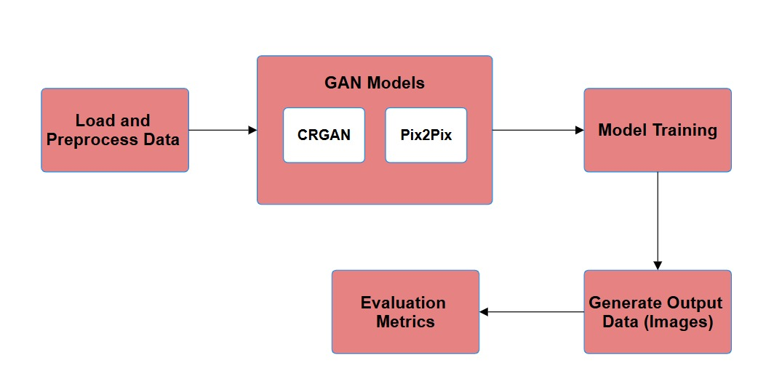
WORKFLOW

Slide 13
Data Preprocessing
Resizing all the images to a particular dimensions.
Converting the images into tensors which scales pixel values from 0 to 255 to a range of 0 to 1.
Normalize the tensor which makes the pixel values to –1 to 1, which will stabilize the training process.

Slide 14
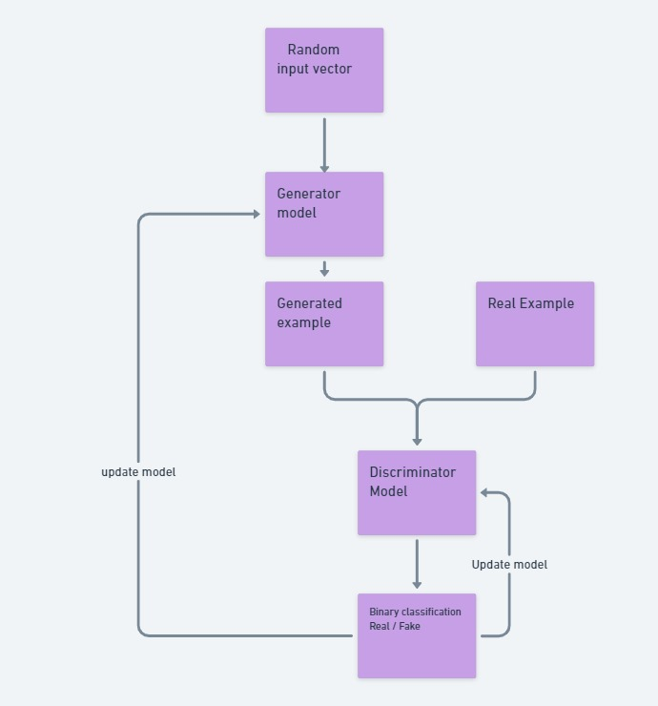
Process

Slide 15
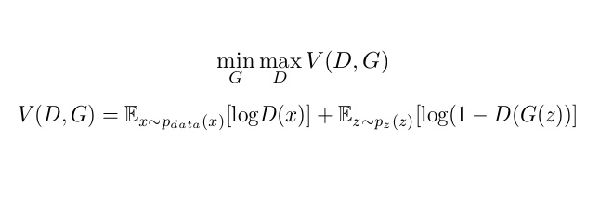
Objective Function
It is a MinMax function where the discriminator maximizes its ability to distinguish real from fake data, while the generator minimizes this by producing realistic fake data

Slide 16
CRGAN Model
We are training our model with all the data. In GANs, the training data is used to simultaneously train both the generator and discriminator, without needing a separate test set.
The generator is a recurrent transposed convolutional network that generates a 3 x 64 x 64 RGB image.
It uses an LSTM layer to combine noise, patient, and stage embeddings into a fused representation and Upsamples the fused representation through transposed convolutional layers.

Slide 17
Model contd..
A final Tanh activation ensures output values in the range [-1, 1].
The discriminator is a conditional CNN that takes a 5-channel input (RGB image + patient and stage embeddings).
It Progressively downscales the input through convolutional layers and ends with a linear layer to output the probability of the image being real or fake.

Slide 18
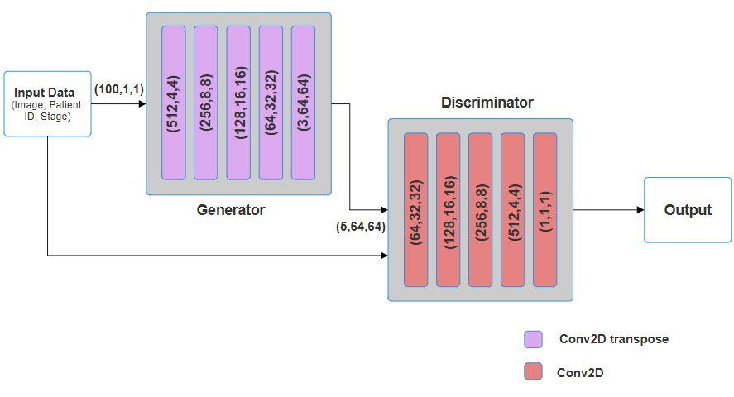
Architecutre

Slide 19

Loss Function : Generator
z: Random noise input to the generator.
c: Conditioning information (e.g., patient ID, stage).
G(z,c): Generated image by the generator.
D(G(z,c)): Discriminator's output for the generated image (real/fake probability).

Slide 20


Loss Function : Discriminator
x is real image
D(x,c): Discriminator's output for the real image.
G(z,c): Generated image by the generator.
D(G(z,c)): Discriminator's output for the generated image.
λ_{gp} : Gradient penalty coefficient.
L_{gp} : Gradient penalty loss.

Slide 21
HYPERPARAMETERS
Name | Size/Numberr
Learning Rate | 0.0001
Gradient Penalty Weight (λ_{gp} ) | 10
Batch Size | 32
Latent Vector Dimension (nz) | 100
Feature Maps in Generator (ngf) | 64
Feature Maps in Discriminator (ndf) | 64
Epochs | 1000

Slide 22
Activation Functions
Name | Name of Activation Function
Discriminator | LeakyReLU
Generator | ReLU and LeakyReLU
Generator Output | Tanh
Discriminator Output | Sigmoid

Slide 23
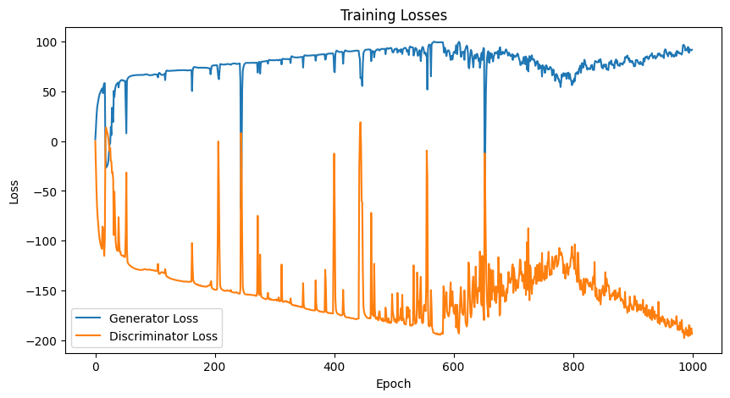
Results

Slide 24
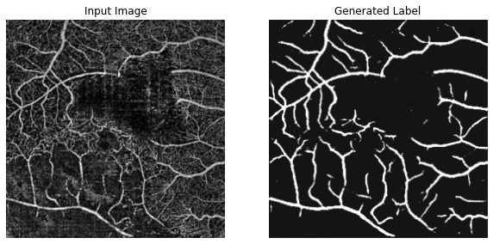
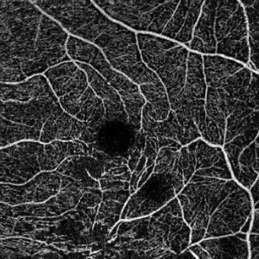
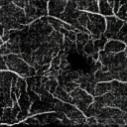
Results

Slide 25
Results
We have also found the Cosine similarity and mean square error.
Metric | Value
Structural Similarity (SSIM) Index | 0.72
Mean Square Error | 0.33

Slide 26
PIX2PIX Model
We are training our model with all the data. In GANs, the training data is used to simultaneously train both the generator and discriminator, without needing a separate test set.
After Preprocessing the data we'll be loading the data in terms of image and label pairs.
The generator is an encoder-decoder network with skip connections that takes an RGB image of size 3 x 64 x 64 as input and outputs a grayscale image of size 1 x 64 x 64.
It uses convolutional layers to down sample and transposed convolutions to upsample, with skip connections to retain spatial information.

Slide 27
Model contd..
A final Tanh activation ensures output values in the range [-1, 1].
The discriminator is a CNN that takes a concatenated 4 x 64 x 64 input (image and label) and outputs the probability of the image being real or fake.
It progressively downsamples the input through convolutional layers, ending with a Sigmoid activation for a final probability.

Slide 28
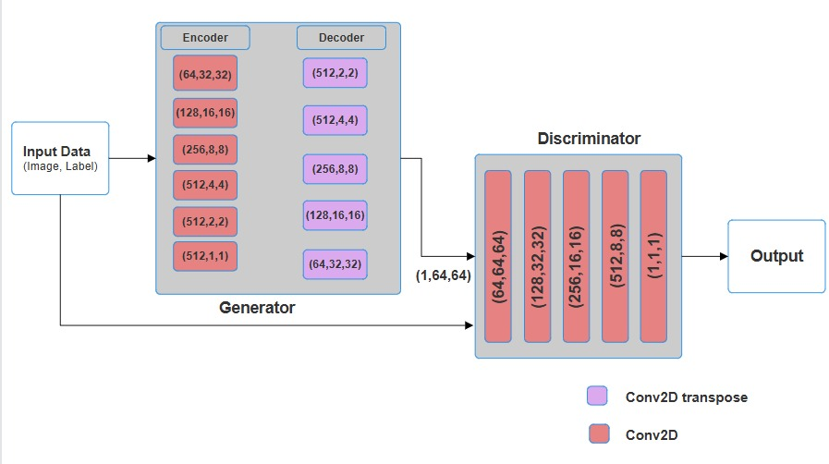
Architecture

Slide 29




Loss Function : Generator
λ_{L1}​ and λ_{L2​} are weights controlling the impact of the L1 and L2 losses.

Slide 30
Loss Function: Discriminator
x is the input image, y is the real label, and G(x) is the generated label

Slide 31
HYPERPARAMETERS
Name | Size/Numberr
Generator Learning Rate | 0.0002
Discriminator Learning Rate | 0.0001
Batch Size | 32
Lambda L1 λ_{L1} | 200
Lambda L2 λ_{L2} | 10
Epochs | 500

Slide 32
Activation Functions
Name | Name of Activation Function
Discriminator | LeakyReLU
Generator | ReLU
Generator Output | Tanh
Discriminator Output | Nothing(as it is a score)

Slide 33
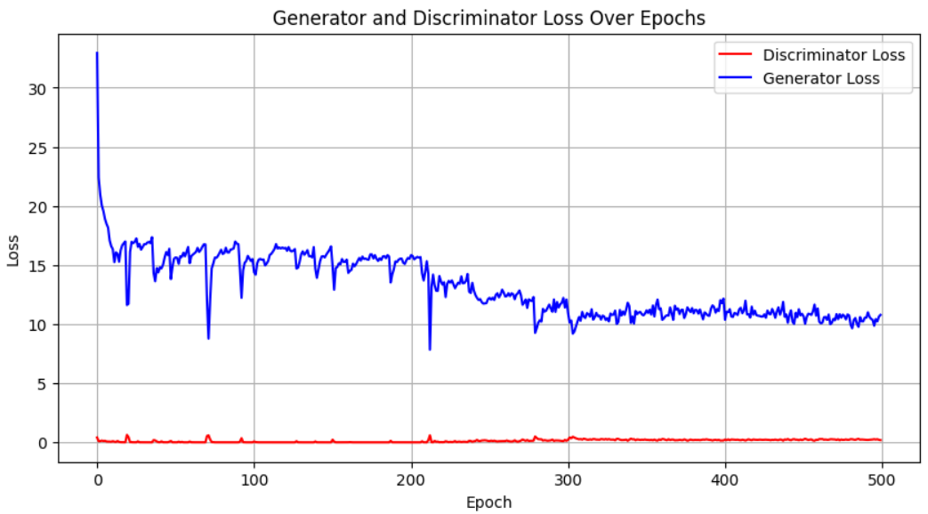
Results
Loss Function for PIX2PIC GAN model

Slide 34
Results

Slide 35
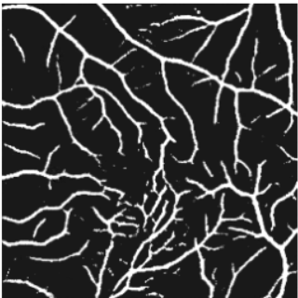
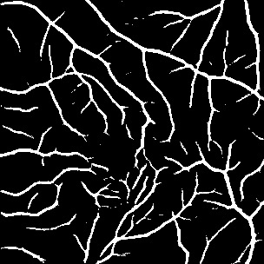
Generated Label
Original Label

Slide 36
Results
We have also found the Cosine similarity and mean square error.
Metric | Value
Cosine Similarity | 0.91
Mean Square Error | 0.13

Slide 37
Conclusion
We have created 2 GAN model which are capable of generating new images of an eye and generating label mask for the images.
Pix2Pix GAN model is able to generate label mask which is outperforming the original image in some cases.
CR-GAN model is struggling to generate the images which are clearer and realistic.

Slide 38
Future Works
Need to improve the performance of CR-GAN model and make it give images which are more related to a specific patient and Create data for Missing classes.
Make a framework integrating the 2 GAN models where if you give the patient id and stage, the model will be capable of generating images.
Make another GAN model which will tell the intensity of the BRVO disease.

Slide 39
References
[1] A Two-Stage GAN for High-Resolution Retinal Image Generation and Segmentation
https://www.mdpi.com/2079-9292/11/1/60
[2] Classification of Multiple Retinal Disorders from Enhanced Fundus Images Using Semi-supervised GAN
https://link.springer.com/article/10.1007/s42979-021-00945-6
[3] Application of generative adversarial networks (GAN) for ophthalmology image domains: a survey
https://link.springer.com/article/10.1186/s40662-022-00277-3

Slide 40
Thank you

